Slide 1


Basic Details of the Team and Problem Statement
Codictive 1.0 State-Level Hackathon
PS Code: ED001
Problem Statement Title: Challenge of fake certificates circulation
Team Name: Ace
Team Leader Name: Ayush Jadham
Institute Name: Bansal institute of science and technology
Theme Name: Edtech Domain

Slide 2
Approach Details
The step is to ensure that the certificates being presented are genuine. This can be done by verifying the certificate issuer, checking the certificate's unique identifier or serial number, and cross-checking the certificate against a database of valid certificates.(layer 1)
Block chain technology can be used to create a tamper-proof system of storing and verifying certificates. This can help prevent the creation of fake certificates or the alteration of genuine ones.(layer 2)

Slide 3
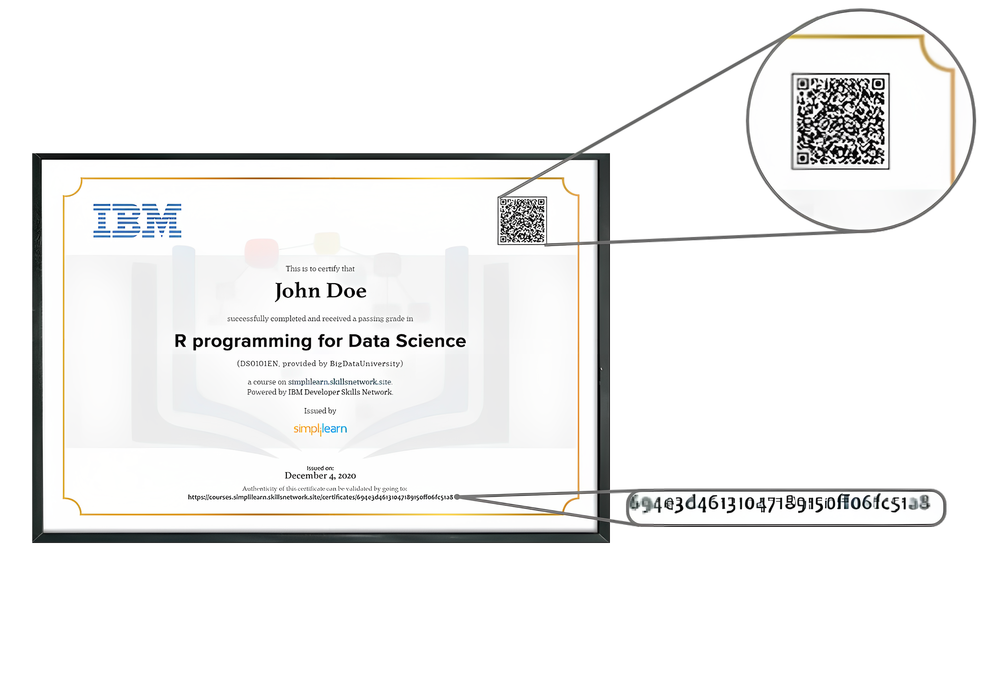
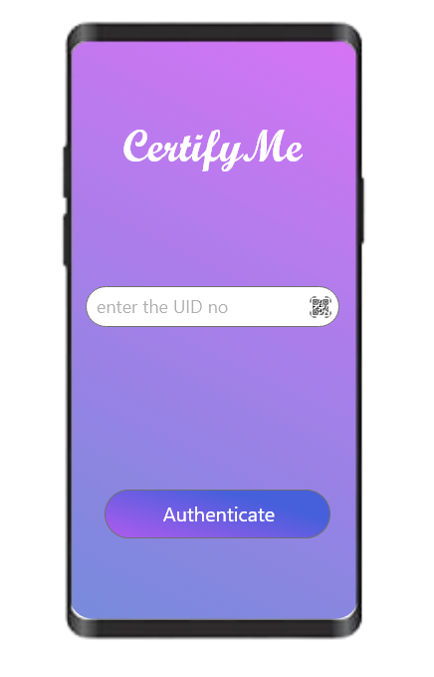
Layer 1(Client side application)
Issuing authority generated Qr code
Issued UID (Unique Identification numbers)by authority
Certificate
User App

Slide 4
Layer 2 (Decentralized Database)
Issuance of Certificates: Certificates can be issued digitally by institutions and organizations on the blockchain. This would involve creating a digital certificate in a format that is compatible with the blockchain technology, and then uploading it onto the blockchain. Once uploaded, the certificate is given a unique identifier, also known as a hash, which is stored on the blockchain.
Verification of Certificates: Verification of certificates can be done by anyone with access to the blockchain. To verify a certificate, one would simply need to input the unique identifier or hash of the certificate into the blockchain. The blockchain would then check whether the hash matches the one stored on the blockchain. If it does, then the certificate is considered valid and tamper-proof.

Slide 5
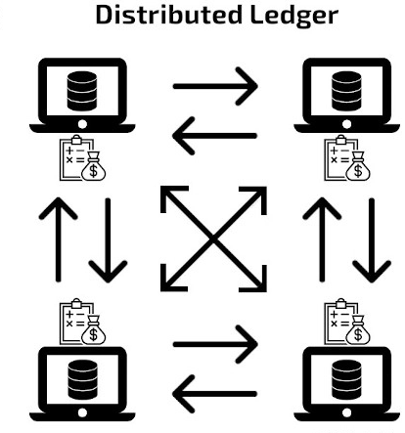


Slide 6
Add process flow chart or simulated image of prototype or any relevant image related to your idea

Slide 7
Technological stack
Front-end Technologies:
Java or Kotlin: These are the core programming languages used to build the user interface and application logic.
XML: This is a markup language used to define the structure and layout of the user interface.
Back-end Technologies:
Node.js, Python. These are popular server-side programming languages for building the back-end of the application.
Express.js, Flask: These are popular web application frameworks that run on the server-side and provide the structure for building the back-end of the application.
Database Technologies:
SQLite: This is a popular embedded relational database management system that is commonly used for Android app development.
Firebase: This is a cloud-based platform that provides a NoSQL database, real-time data synchronization, and hosting services.

Slide 8
Approach Details
Use Cases
Dependencies
To ensure the authenticity of the certificate: Verification helps to confirm that the certificate is not counterfeit or fraudulent.
To verify the identity of the holder: Verification allows for confirmation that the individual presenting the certificate is the same person who earned it.
To maintain the integrity of the certification process: Verification helps to ensure that the certification process is fair and unbiased, and that standards are maintained.
Dentity management: Blockchain can be used to create a decentralized identity management system that can be used to manage identity verification and authentication. This can help to reduce the risk of identity theft and fraud.
Voting systems: Blockchain technology can be used to create secure and transparent voting systems that can help to prevent election fraud and ensure that election results are accurate and trustworthy.

Slide 9
Team Member Details
Team Leader Name: Ayush jadham
Branch (Btech) Stream ( CSE ) Year (II)
Team Member 1 Name: Aayushi Mishra
Branch (Btech) Stream ( CSE ) Year (II)
Team Member 2 Name: Kanak Virhe
Branch (Btech) Stream ( CSE ) Year (II)
Team Member 3 Name: Ayushi Nagar
Branch (Btech) Stream ( CSE ) Year (II)
Team Member 4 Name: Bhupendra Rathoriya
Branch (Btech) Stream ( CSE ) Year (II)

